Slide 1
Every Picture Tells a Story, Don’t It... © Rod Stewart
Forest Photography Designed to Document and Monitor Forest-Climate-Change (CFC)
©
Roger L. Merchant ME-LPF 727
Forester & Photographer
1018 Pushaw Rd, Glenburn, Maine
rogmerch@gmail.com / 207-343-0969
Notes:
Can still-image photography play a role in monitoring climate-forest-change?(CFC)... I believe so. This is what Every Picture Tells A Story is about.

Slide 2
The Map... December 13, 2019
Speak to - illustrate - the qualitative value of still image photography in documenting forests and possible applications to CFC.
Forest photography and human connections
Practices that yield high quality visual data
Documentation of 50 years of change
Possible applications of still photography to place-based CFC monitoring that engages citizens, communities, scientists.
Q&A
Notes:
>> Bierman, and UVM colleagues, 2005 would concur...”Historical photographs are a powerful tool for understanding the distribution of surficial processes, physical and biological, on the time-scale of decades and centuries, and are valuable for understanding human-landscape interactions”...
+ So, I’ll frame some forests related to CFC and make some human-landscape connections
+ I’ll outline key practices for capturing high quality images (+caveat: not dismissing drones-modeling- iphones)
+ We’ll give a gander to The 1942-2016 Forest, illustrating 50 years of change through photography.
+ I’ll reinforce some collaborative possibilities about place-based photographic monitoring of CFC
>> (CFC) is Climate-Forest-Change

Slide 3
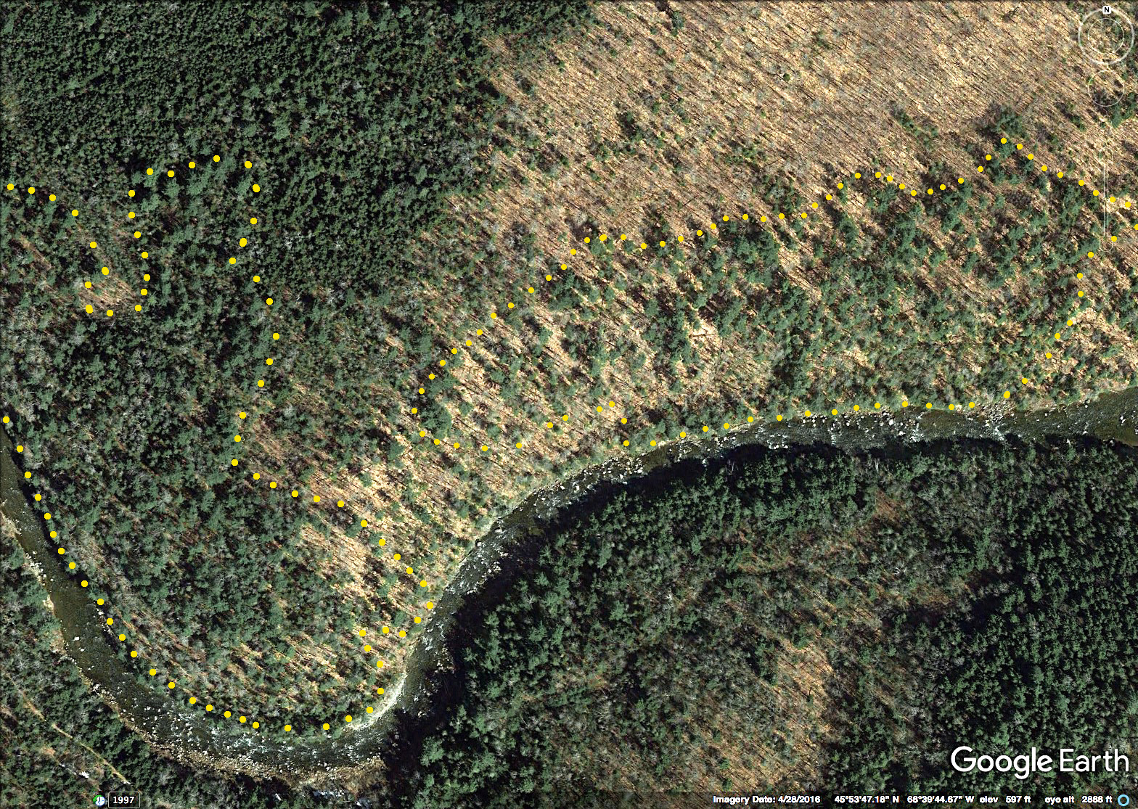
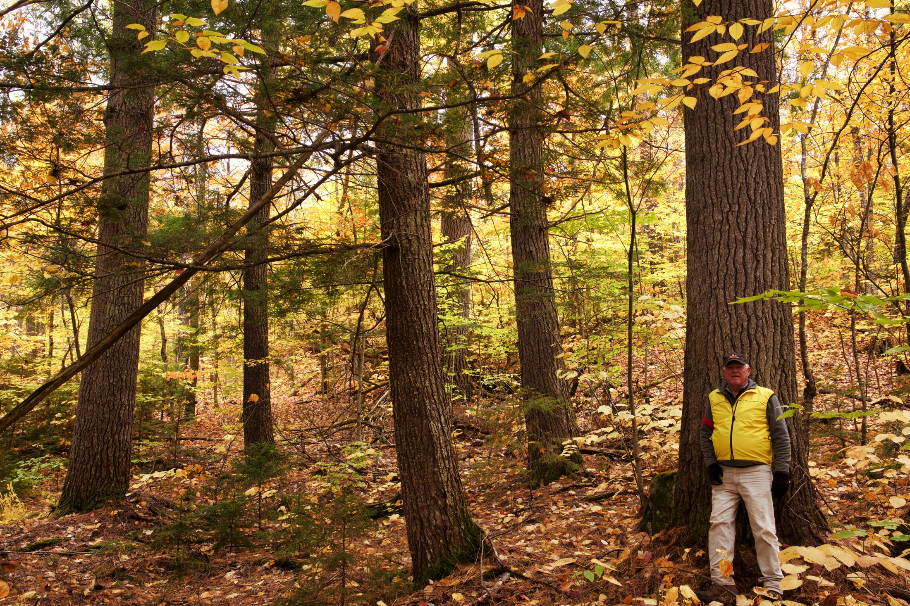
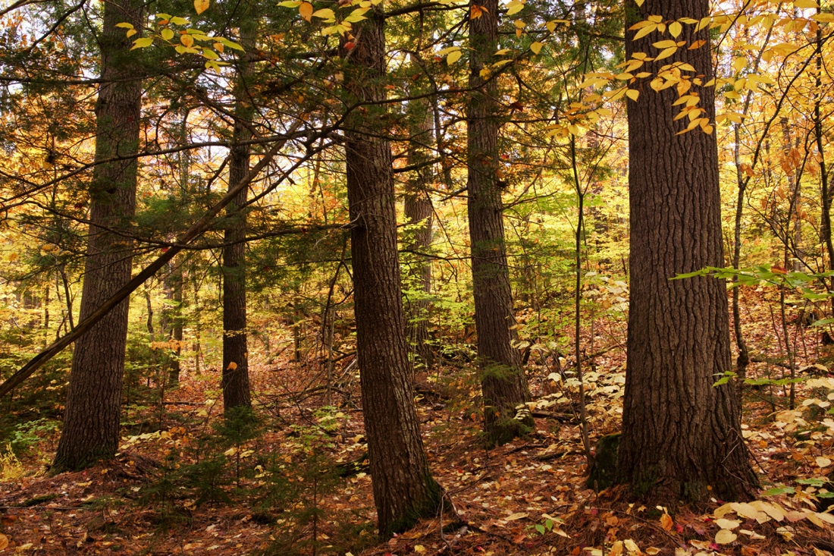
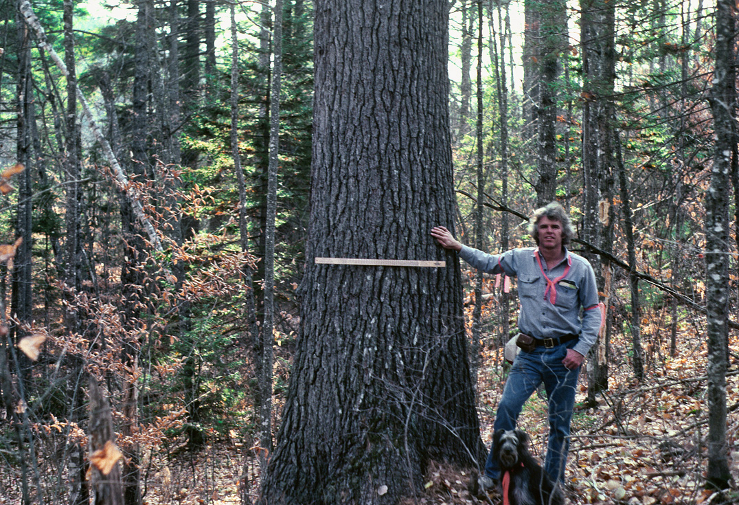
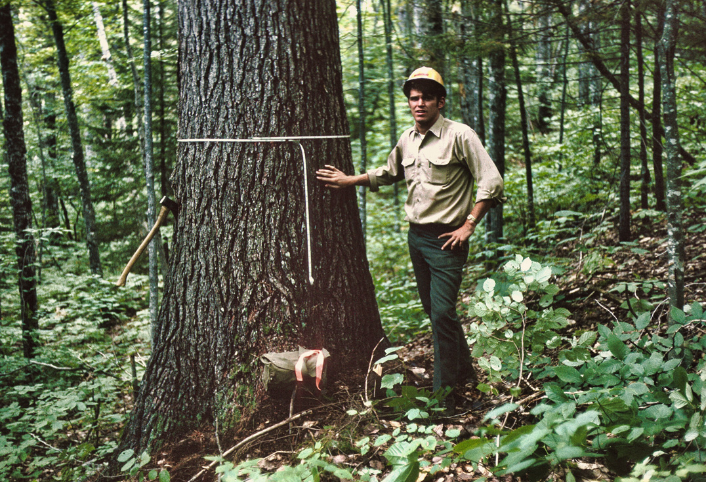
OGF: Human Interest & Legacy...
1967 >>..........................................<< 2018
Notes:
F1... in the late 1960’s I discovered a 15 acre OGF on Baskahegan Lands adjacent to Wassataquioik Stream east of Katahdin...(AP: yellow dots)... I prevailed upon the company to set this old forest aside. Here are snapshots of this legacy forest, now and then.
F2... 2018, the OGF alone and devoid of humanity...
F3... 2018, with the presence of human interest, altering the meaning of the forest scene...
F4... 1983, the OGF, on my 40th
F5... 1968, when it was documented-protected...
That wise silvicultural professor David Smith, consultant for Baskahegan, reminded me in later years to remember my forest legacy, from where my boots had been on the ground early in my career. In 1968, my young idealized self had little appreciation for forest history and the legacy handed to me, generation by generation. I see how this marked my entre’ into forest protection and photographic documentation.... And indeed, a very long-term commitment is implicated in monitoring CFC, photographically or other wise.

Slide 4
TOOLS + SKILLS for Quality Images
Tools: DSLR w/24-70 mm + Telephoto 70-200/300 + TRIPOD + RAW/jpeg + GPS
Skills: Frame-Compose... Aperture Priority to Assess-Control DoF
Adjust for Hi-Lo Contrast light (+/- 3/f)... Post-processing
RM: Site - Scene Selection - Composition:
+ Consider what I want to capture visually
+ Walk quietly - Take in – Immerse -Visually-in-Motion.
Something begins to visually speak to me !!!
+ Park the Camera - Walk the Scene - Apply Vision 360
+ Forest Structure... Hi-Lo Light... CFC Associations
+ Look - See - Frame... Simplify - Less is More... Reframe.
+ Set tripod & GPS... Frame... Distraction Check... Reframe... Shoot +/-3 /f ... 4x Compass Rose... Another angle... Field notes
GOAL: Visually clarify and frame the forest features that you want to bring into your CFC scene...
Notes:
+ Like the d’tape, a camera is a forest documentation tool... Here are some basic considerations about tools, skills, composition (handout copy)
+ Tools
+ Skills
+ Composition..... Vision 360 = slow rotation / F-B / up and down... Quad by Quad... H-L light ....+/-3/f’s ... 4X = NESW
+ GOAL: Visually clarify and frame forest features that you want to bring into your CFC scene

Slide 5
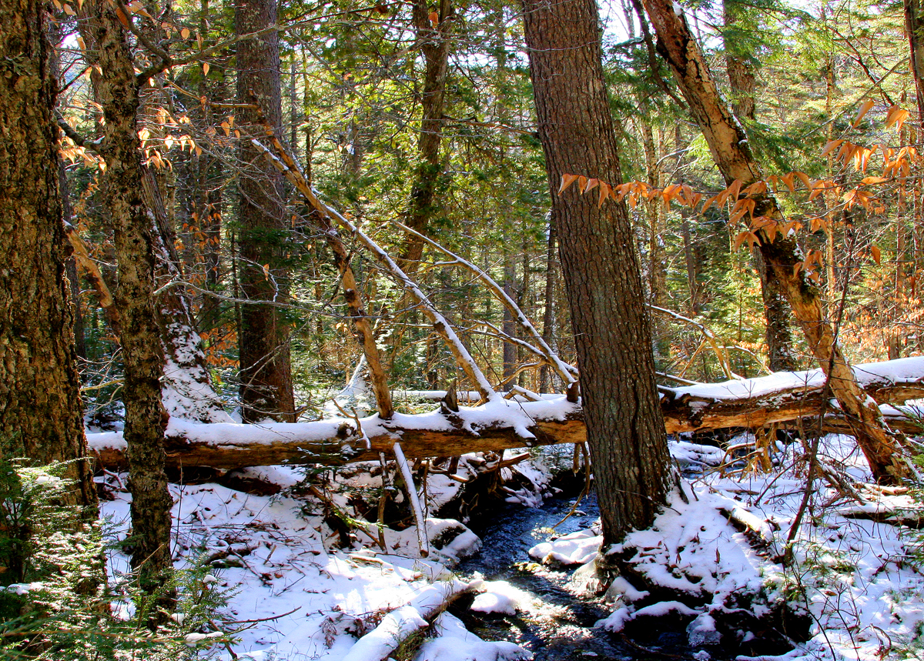
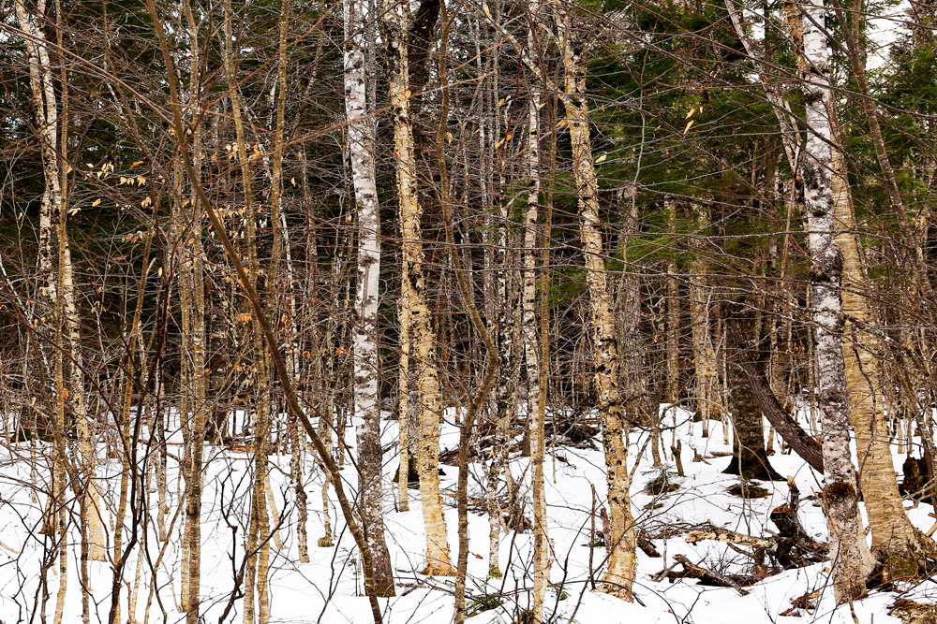
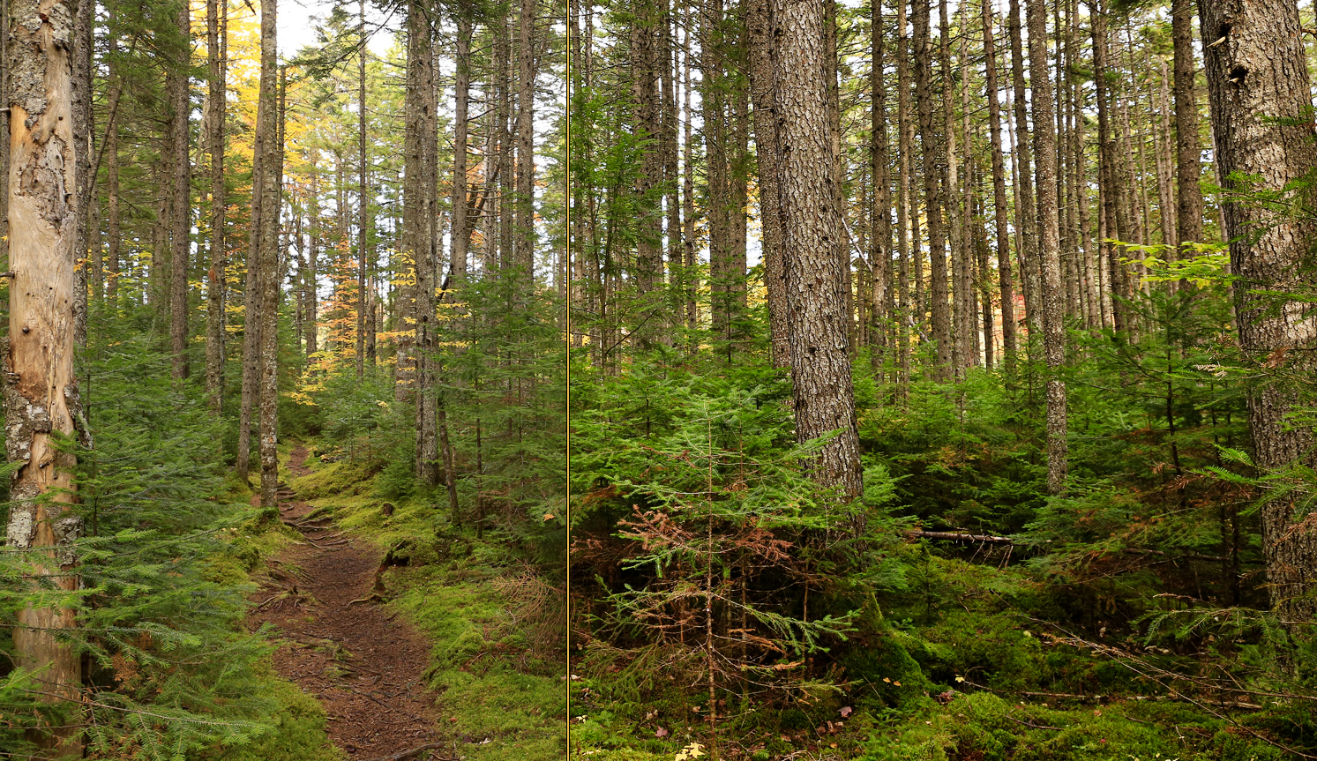
Frame - Compose for Clarity
(45mm; 1/125; f/8 @ 400)
Framed for Structural Clarity
(24 mm; 1/40; f/8 @ 800)
Unedited < > Edited
Notes:
>> F1... Bennetts post “Creating Order in Chaos” (Nature Photography Network), highlights the many challenges that photographers experience when trying to capture the essence of forest scenes... Visual chaos can overwhelm a scene, diminishing its value with too many distractions and too much content in the viewfinder... Visually, less is more
>>F2... In Eliot Porter’s “Natures Chaos”, co-author James Gleick offers this, “a careful observer of nature, without benefit of fast-motion films, can see the dynamics [of nature] frozen in the shapes of rocks and plants. Structure implies history and history infiltrates any solid form”... Indeed, the dynamics of size-age-stage-species visually speak to us of a close, crowded young age in this forest frame
>>F3... This spruce scene is framed for structural clarity... (L<>R + F<>B + V)... From your perspective, would you consider co-locating a photographic and data plot in a scene like this to monitor CFC long-term?

Slide 6
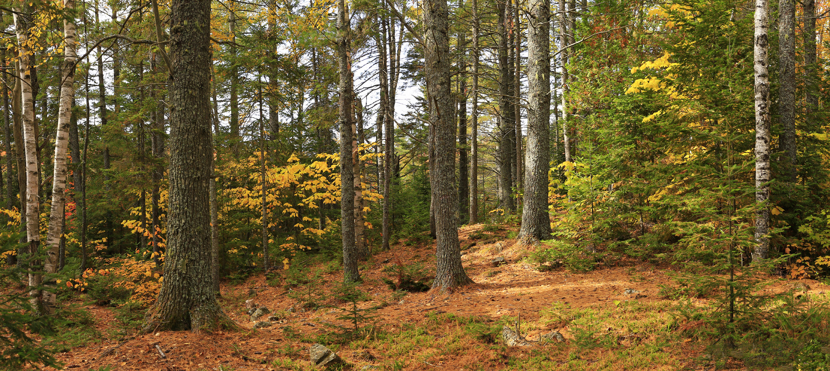
Forest Composition: The Insider View
sp
wp
sp
wp
fir
wb
wb
sp
wp
fir
wp
wb
wp
X
DoF Focus
< 1/3 >
fir
3/3 >>>
O
41 mm; 1/125; f/8 @ 400
Notes:
>>F1... Here are some details about what creates depth in this forest frame... (expansive crown space + open-closed spaces underneath + diversity of tree sizes + arrangement L to R = visual tension)
>>F2... Here’s are 4 species relevant to CFC... The details in this photograph tell us a story about this forest, now-then-and in the future. Might this story become accessible to the public who hear about, but have a limited understanding of CFC? How might we get them into the telling of this picture story with CFC connections? Thus be the challenge in making human-social connections to the forest, let alone climate change.
>>F3... Putting you into Focus at X ... DoF is crucial for capturing tack-sharp images F<>B... Put tripod at X and compose... DoF is about getting both F<>B in-focus... Stop the lens down to aperture f/11+ which extends the range of focus F<>B (If you open the lens-aperture up to F/4, that shortens that range of focus, B goes out-of-focus)... So at f/11+, where do you focus the lens in the overall F<>B scene for optimal DoF? ... Off AF, you manually focus the lens on a point about 1/3rd the way into F<>B scene...

Slide 7
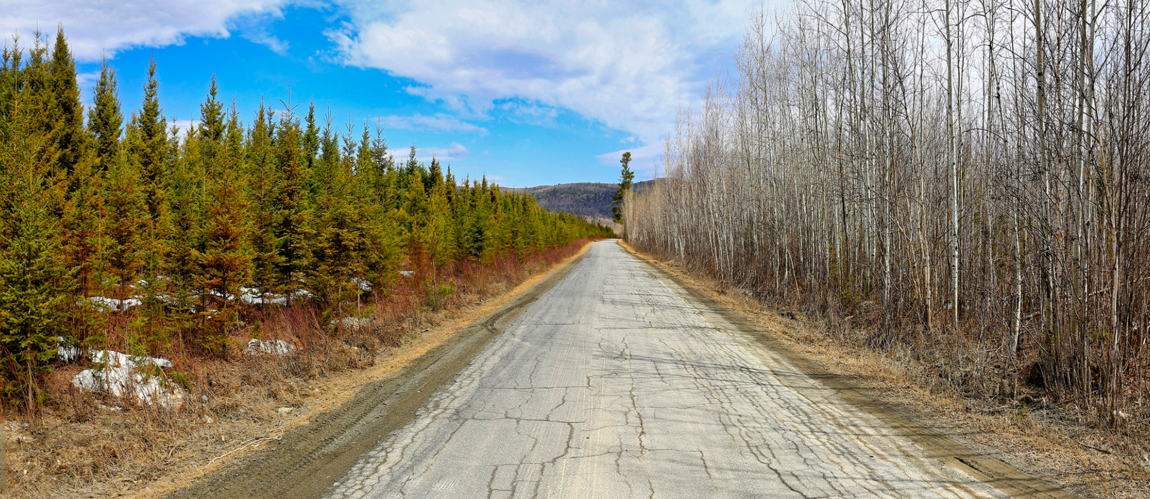
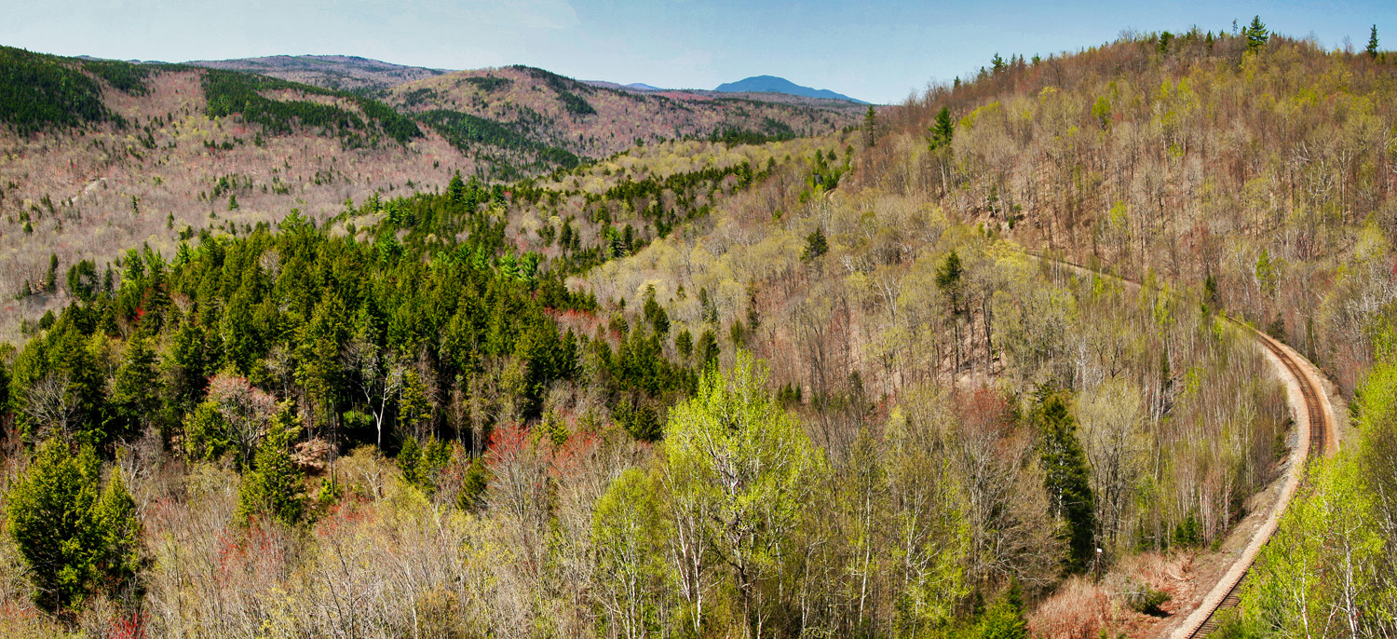
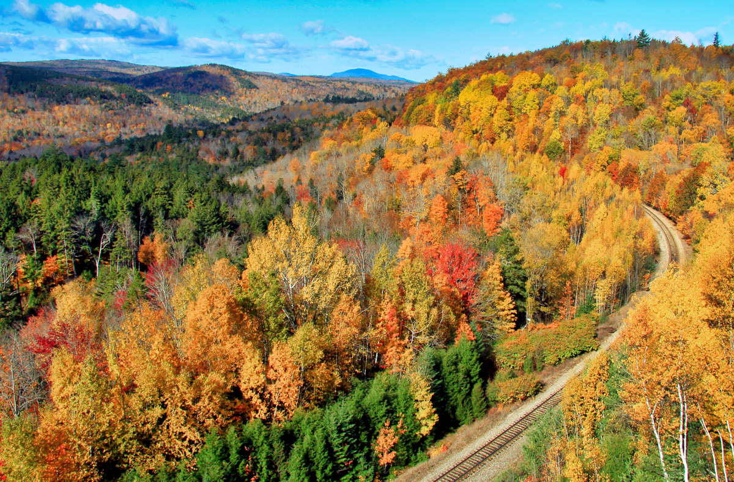
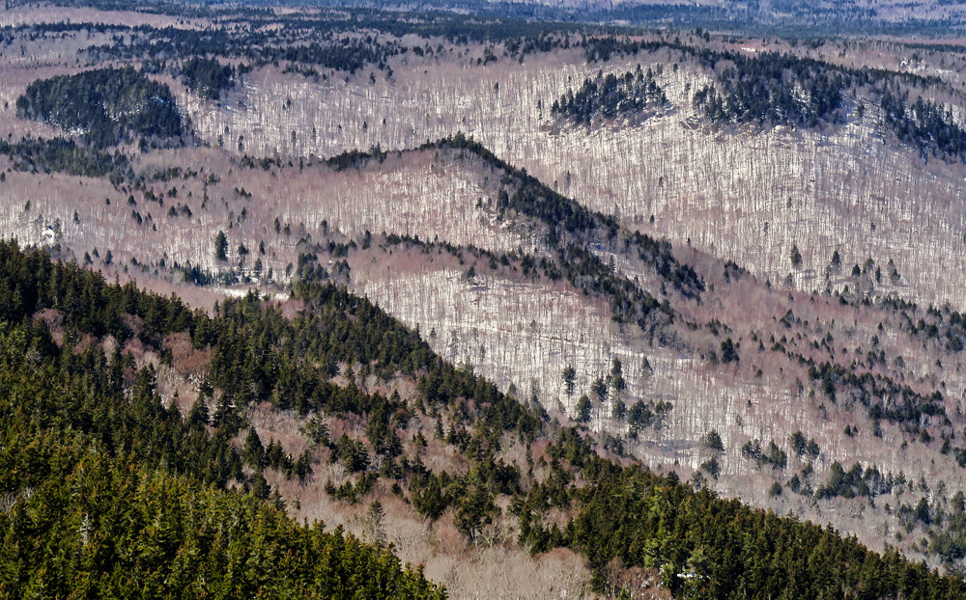
Forest Landscapes: The Outsider View
Growing on the edge
It’s the time of the season for....
What new forest details emerge from this scene?
Pretty picture season, but overwhelmed by color
Notes:
>>F1... Open space gives a broad, external view, where the edges of spruce-aspen meet road and sky
>>F2... At pretty picture time Con-Dec delineations are more pronounced than summer’s green oceanic forest... However, over-ripe saturation like this tends to overwhelm everything else
>>F3... At bud-break Con-Dec edges are more distinct than autumn... Subtle emerging colors associate with species... red w/ Red maple, bright green w/ WB-ASP... Sonnentag, 2011, offer this possibility, “digital repeat photography has the potential to become a long-term data source for phenological research.”
>>F4... Winter clearly reveals the edges and mix of Con-Dec ecosystems... Allen & Breshears, 1998... “GCC shifts in vegetation are expected to be most rapid and extreme at ecotones, the boundaries between ecosystems. Consider this...In the 1950’s, under prolonged drought, a ponderosa-pinion pine ecotone shifted extensively (2km), and rapidly <5 year in the Jemez Mountains of NM”... Granted were moist not arid. But, have we identified Ecotones that might be more prone or vulnerable to rapid CFC changes?
+ Photographing landscapes... 70-300mm telephoto + steady tripod + fast shutter speed 1/250 + delayed release.

Slide 8
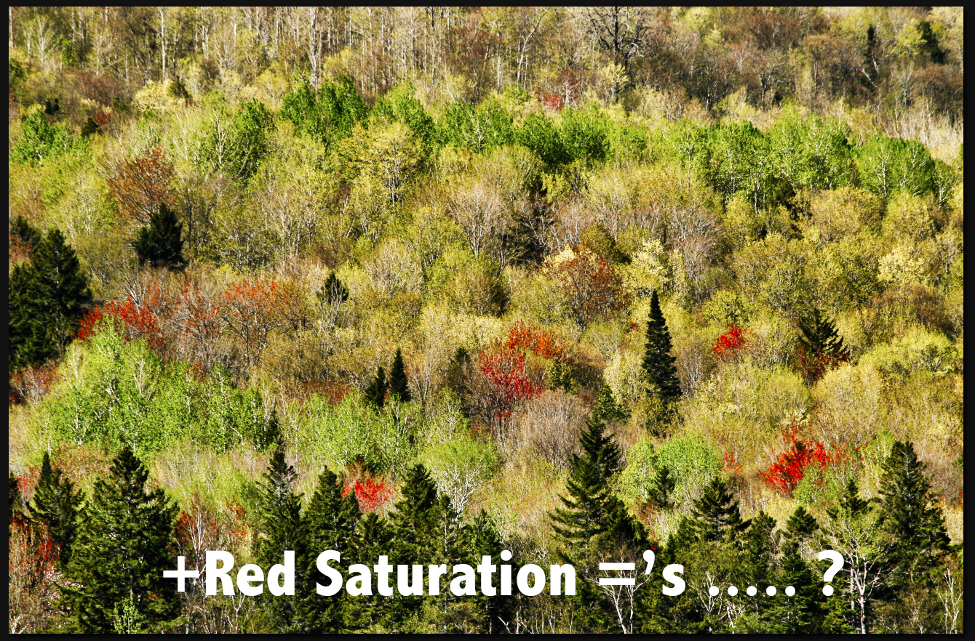
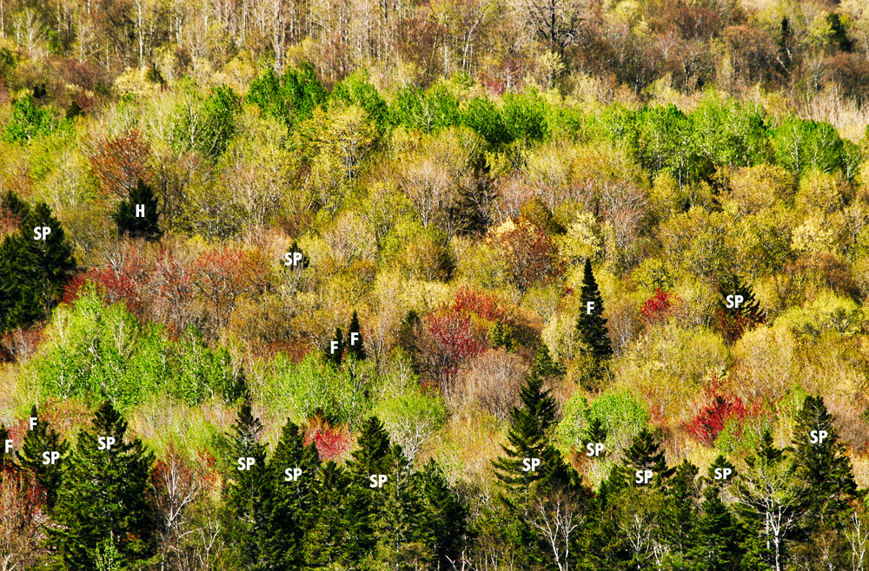
Still here after all these years?
✚
✚
✚
✚
Notes:
F!... This is a hypothetical visual plot at bud-break, delineated by 4 +’s ... A tripod-steady 300mm telephoto provides sufficient detail for distinguishing conifers.
F2... Increasing red saturation pops Red Maple. How many on this plot? Other species have a range of subtle colors and tones: browns, yellows, two shades of green, as well as bark colors and stem details.... As I recall this spring day, I could identify sugar maple, beech, ash, aspen, white birch on-site and see their associated colors ... Might this V-plot have application to documenting who’s still here and who’s gone, over the longer span and legacy of all those CFC years way into the future?
>>> Ok. Lets look at 50 years of change

Slide 9
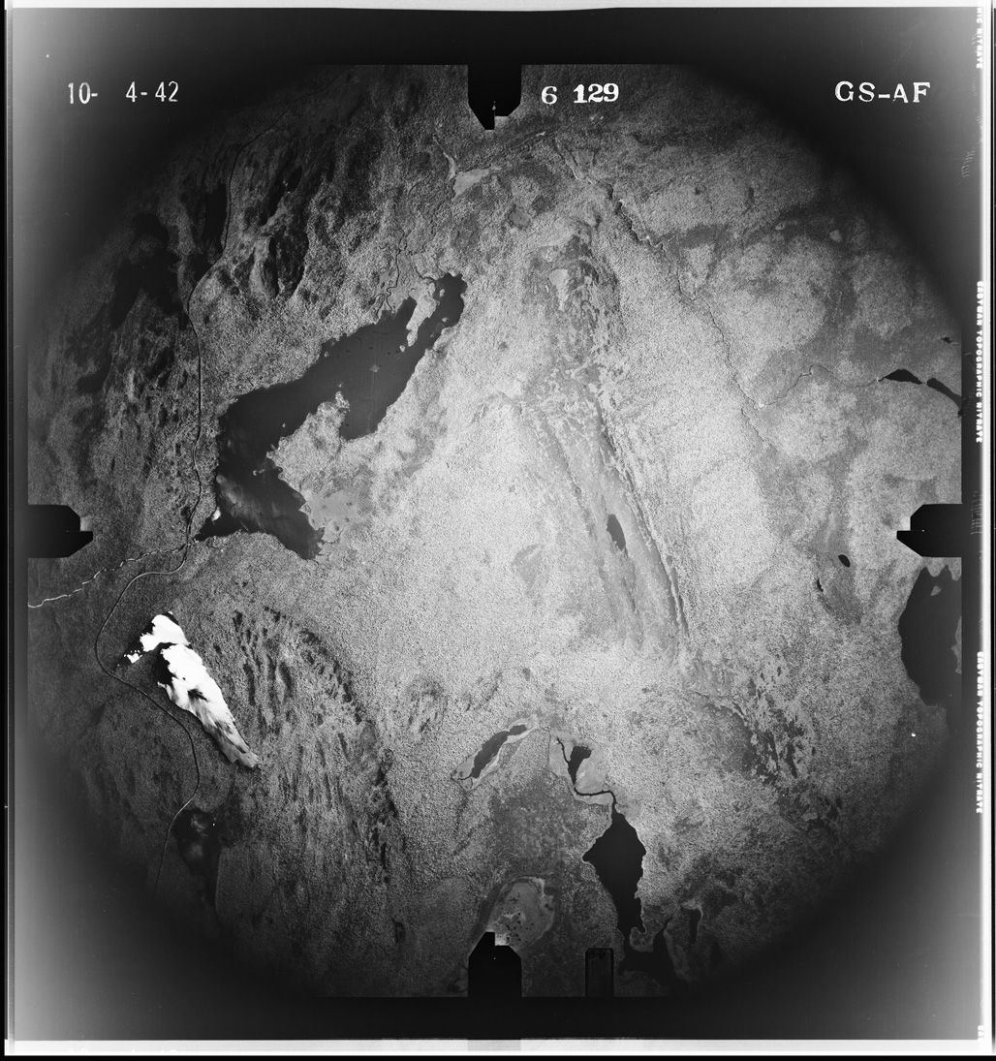
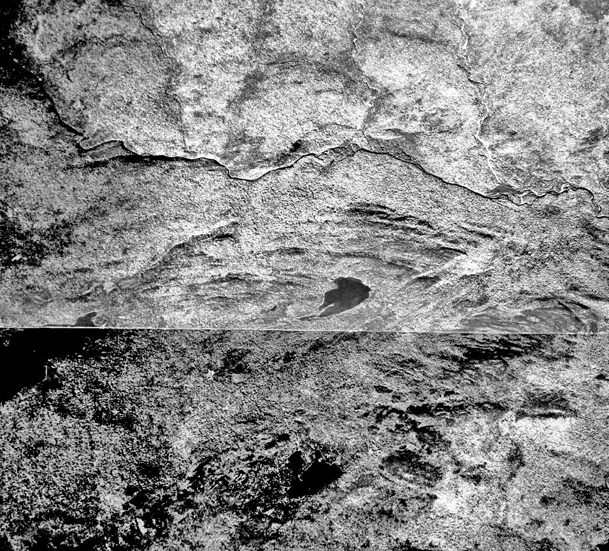
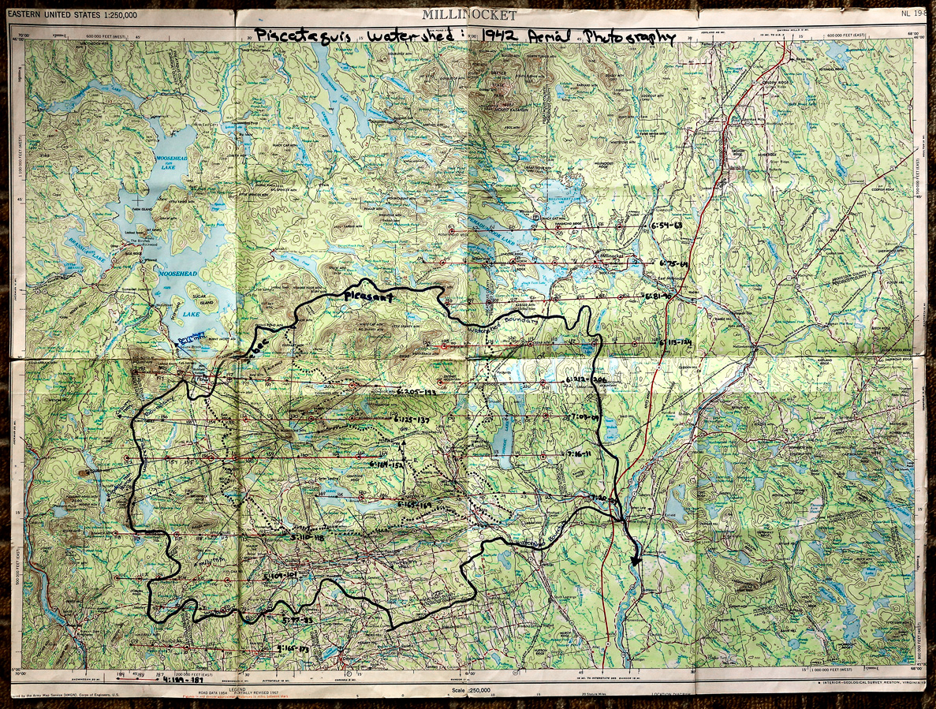
WWII... GS-AF, October 1942...
Notes:
F1... In the early 1990’s a collection of aerial photographs, GS-AF, October 1942 came into my possession
F2... The bulk of the collection was 24 x 24 cut-fold prints
F3... Mapped out old-school on a 1:250,000 USGS, GS-AF 1942 covered the entire Piscataquis Watershed. At the time, pre-digital, I had not considered its legacy value. It sat on the sidelines.

Slide 10
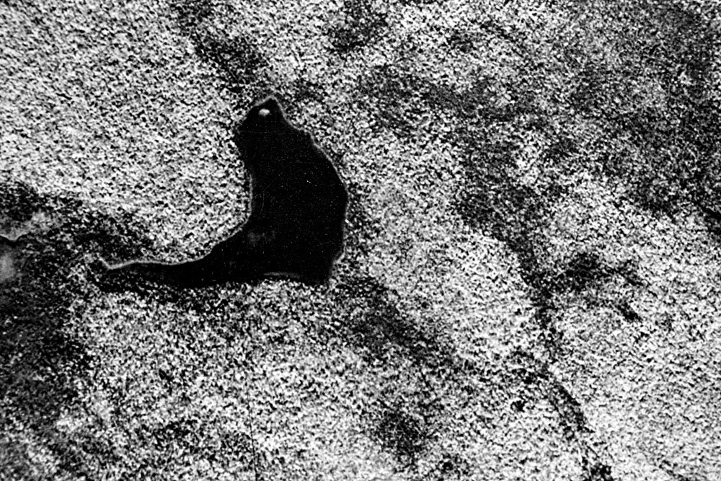
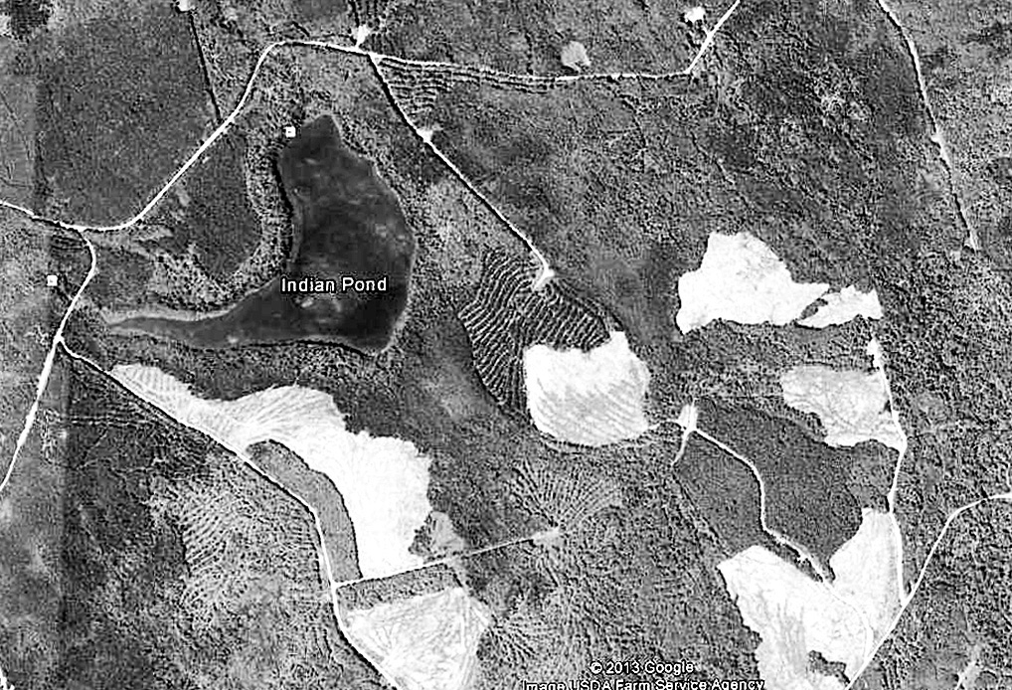
Legacy Retrieval: The 1942-2013 Forest
1990’s: landscape change, clear cutting, parks and conservation
2000: GE evolution, RM test digital photos of GS AF 1942 photos
2013: Dr. Reinhard Moratz UM Spatial Engineering digitizes 1942
What’s the same, different?
Indian Pond
1942
Indian Pond
2013
What do you see, interpret?
Notes:
F1... In the 1990’s forest issues were kicking-up chips everywhere... By early 2000 I was taking digital shots of sections of GS-AF, comparing them to GE images of the exact, same location. The differences were stunning, disturbing to my forestry eyes... In 2013, friend and colleague D.RM took keen interest in the implications of this forest documentation work. His students digitized the entire collection and The 1942-2013 Forest emerged from this collaboration...
F2... Leading off with Indian Pond 1942...
F3... paired with Indian Pond 2013... (FB Page)... Given the dramatic alteration in forest cover and forest structure from 50 years of change, I wonder what the CFC implications might be for the future of this newer, highly fragmented forest?
Eyes...
Continuous and fragmented forest cover
Types of forest cover
Age of forest cover
Extent of natural and man-made openings
Extent of buffer cover around water bodies and wetlands
Extent of deer yards
Habitat alterations
Influences...
Landownership overlays
Conservation easements
Public Lands
P&P Manufacture
FP Manufacture
Forest Related Employment

Slide 11
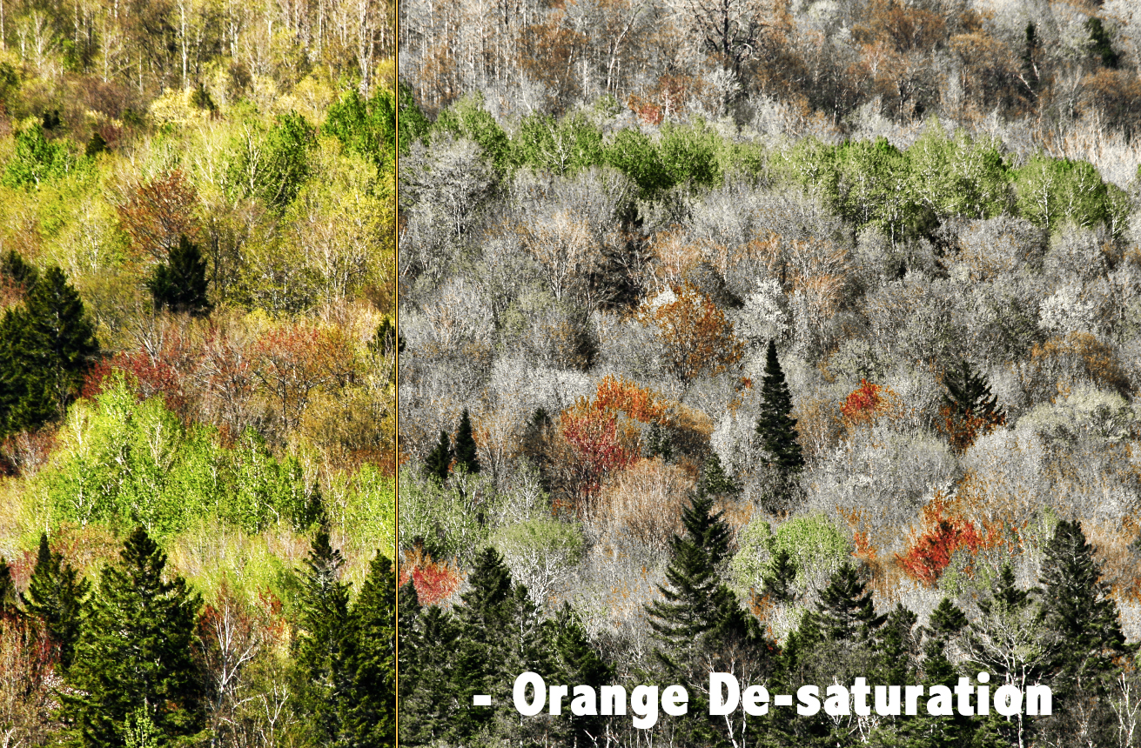
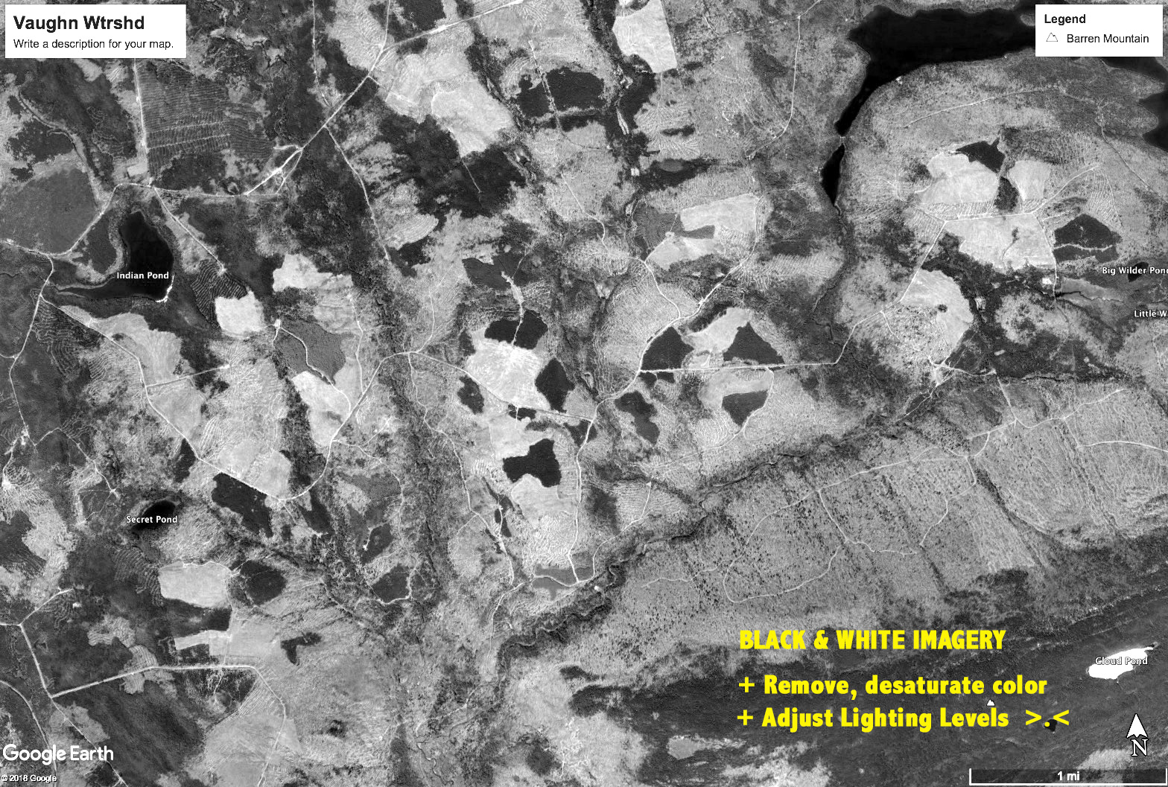
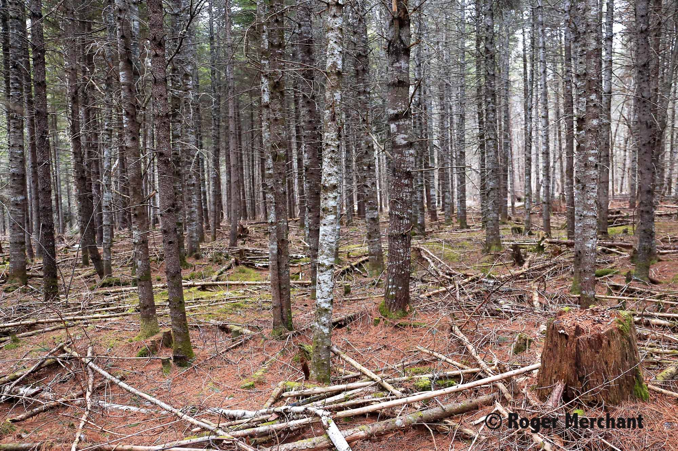
Seeing through the human-viewfinder-camera-lens, and out into the forest
From a distance
seasons matter
High Q forest photography
yielding qualitative data
Forest history- legacy
ID vulnerable
sites & zones
Changing ecotones & landscapes
Notes:
We’ve been looking at the potential of still forest photography as a qualitative research tool for documenting CFC. To me, it seems to be complimentary with quantitative CFC data and analysis, and I would also add....especially when the picture and the data together tell a place-based story about what’s emerging in the backyard forests of local people, that’s the human-social connection in CFC.
...bringing us to the final frame....

Slide 12
Place-Based Photographic Monitoring
What: Local photography that can contribute to local CFC monitoring
+ Place-based sites, V-Plots
+ Local islands in the sky
+ Sites at “high risk” for migration N
+ Species “at the edge” of natural range
+ Highly fragmented forests
+ Woodlots and town forests
+ Conservation lands, etc., etc.
Who:
Collaborations of interest...scientists... citizens... communities... kids & families... cameras in hand... a web-platform to document-share findings...
Why:
Notes:
>> What? As we’ve already seen, these are but a few of the many possibilities for photographic monitoring... place-based ...locally
>> Who? ... Why not through collaborations involving local people - communities - scientists in the research and documentation of CFC, locally?... But that’s a lot of work! Remember ye’ old rural mantra about tough jobs, ... “it takes many hands”... Why not put more local hands on the wheels of the stuck CFC log truck, move the dagone thing on out of the swamp of doubt and suspicion by getting local folks acquainted, hands-on, with those conducting the research? Could folks from local communities provide long-term photographic documentation of research selected CFC sites? I think so, maybe in some ways similar to FEMC’s collaborative engagement with Mountain Birdwatch’s citizen scientists (FEMC 2018)
>> Why Place-based? In addition to working with local values where “it takes many hands”, rural folks - their community - the immediate environment, all are intimately connected. Locally-socially-biophysically, this defines people and place where the short and longer term impacts of CFC will occur and be felt ... Engaging local people in developing details about what’s changing in their local forests, doesn’t that give them some skin in the game? ... Place-based photographic monitoring of CFC, brings forests and people into the viewfinder, and onto the photograph, capturing forest conditions and contributing human-interest connections to Every Picture Tells a C-F-C Story, Don’t It?...
Thank you.

Slide 13
References
Bennett, Eric, “Order in Chaos”, Nature Photographers Network, 2018. (https://naturephotographersnetwork)
R. Bierman, et.al, “Old Images Record Landscape Change Through Time”. University of Vermont, GSA, 2005.
Allen, C. & Breshears, D., “Drought-Induced Shift of a Forest Woodland Ecotone”. National Academy of Academy of Sciences, December 1998.
Sonnentag, Oliver, et.al, “Digital Repeat Photography for Phenological Research in Forest Ecosystems”. ELSEVIER September 2011.
Kelley, Ronald, “Forest Canopy Health-Photographic Method for Monitoring”. Vermont Department of Forests, Parks, Recreation, 1993
Karunungan, Renee’ and Rashi, Probal, “Can Photography Change the Way We See Climate Change?’ April 19, 2018
Porter, Eliot and Gleick, James, “Natures Chaos”. Viking Penguin Books, 1990
FB: The 1942-2016 Forest

